Slide 1

Exam AI-100: Designing and Implementing an Azure AI Solution Crash Course
Tim Warner

Slide 2
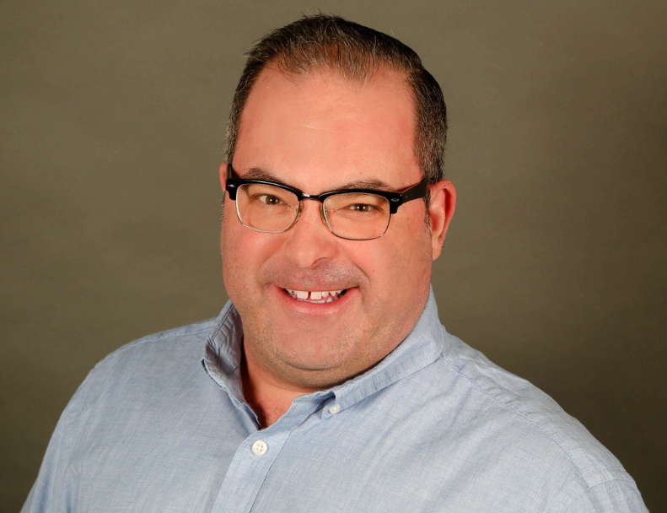

Tim Warner
Based in Nashville, TN, US
MCT, MVP
Twitter: @TechTrainerTim
Badge: timw.info

Slide 3
Course Materials
timw.info/ai100

Slide 4
Session 1 of 2 Learning Goals
Introduction
asdf

Slide 5
Session 2 of 2 Learning Goals
asdf

Slide 6
Setting Expectations
This is a "crash course"
Plan to review these materials more than once
Five-minute break at midpoint
Please ask/answer questions and provide feedback in the Q/A panel, not the group chat

Slide 7
Tim's Certification Study Pyramid
Interdependence
Content knowledge
Practical application
Test-taking skills

Slide 8
Section Title

Slide 9
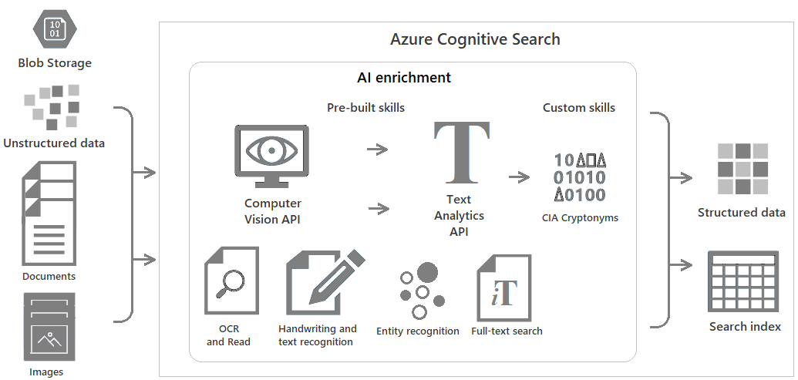
Azure Cognitive Search
https://timw.info/c6ab1

Slide 10
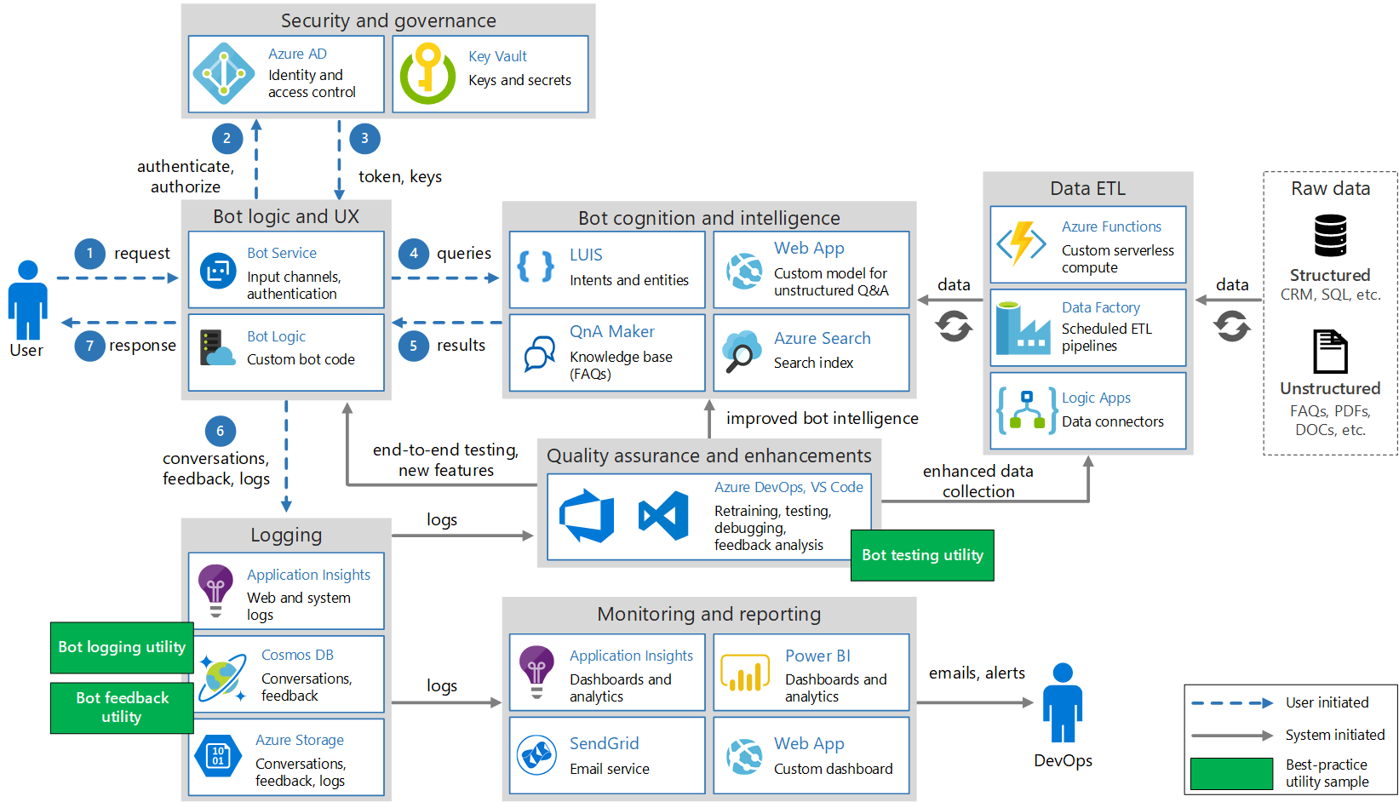
Conversational Bot
https://timw.info/32e9e

Slide 11
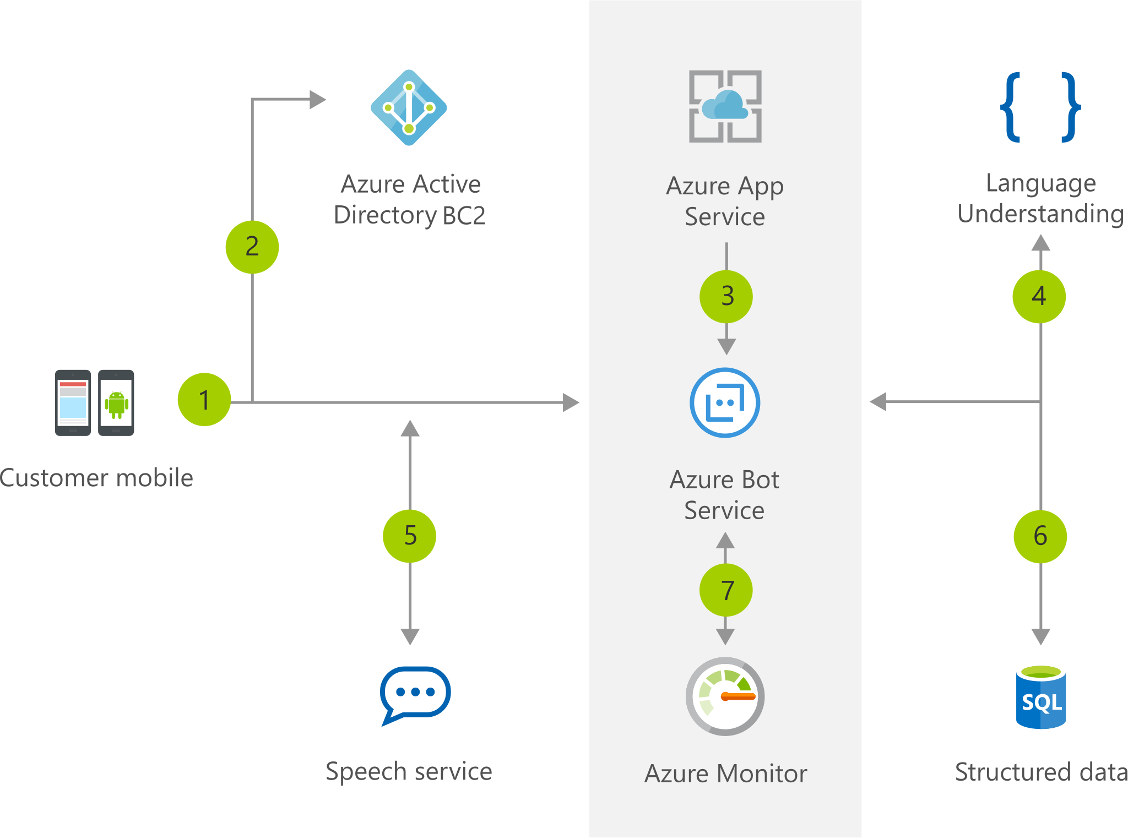
Chatbot
https://timw.info/b04eb

Slide 12
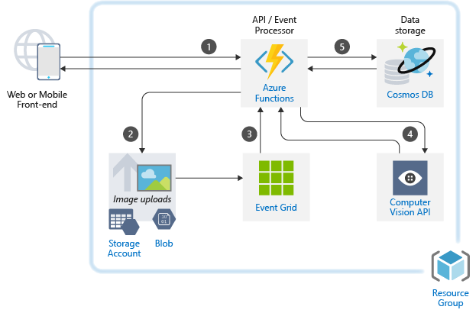
Image Classification
https://timw.info/caa25

Slide 13
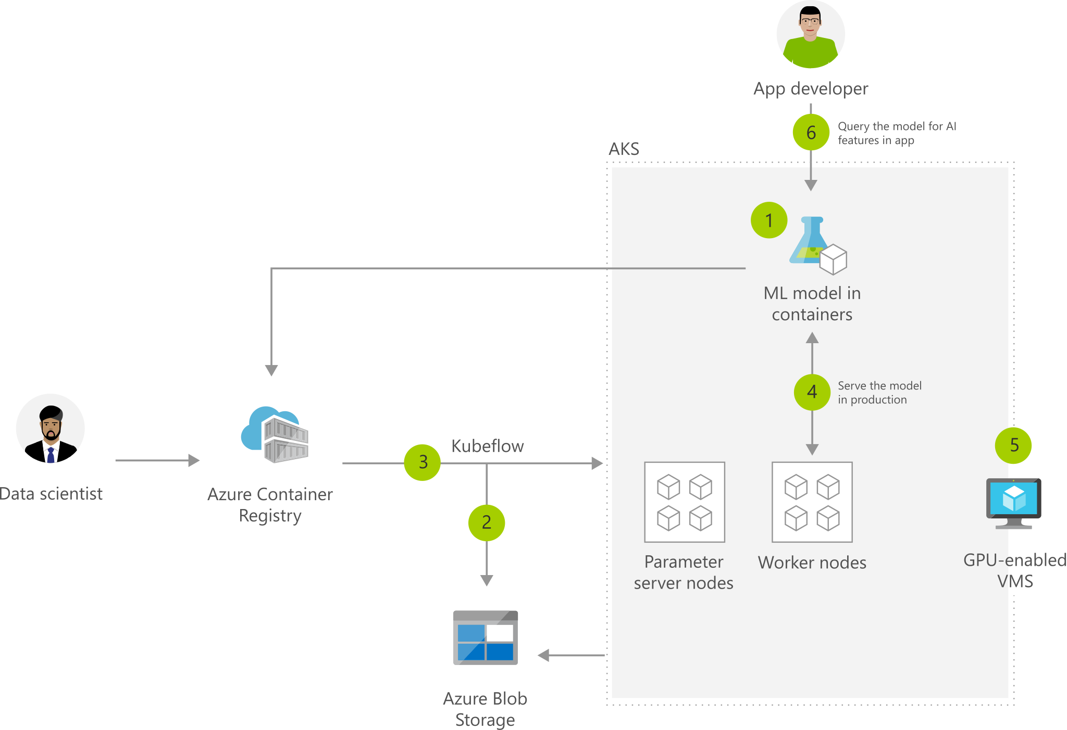
Machine Learning with AKS
https://timw.info/2b505

Slide 14
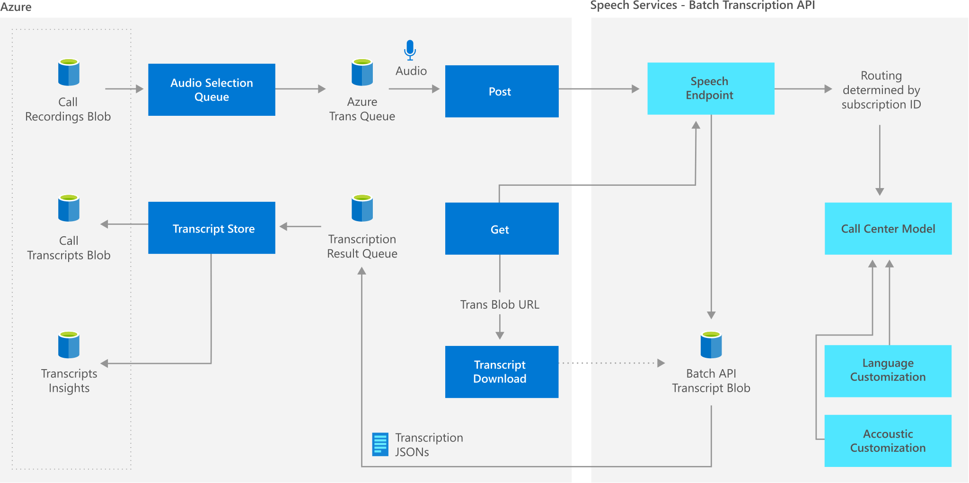
Speech Services
https://timw.info/9b1bc

Slide 15
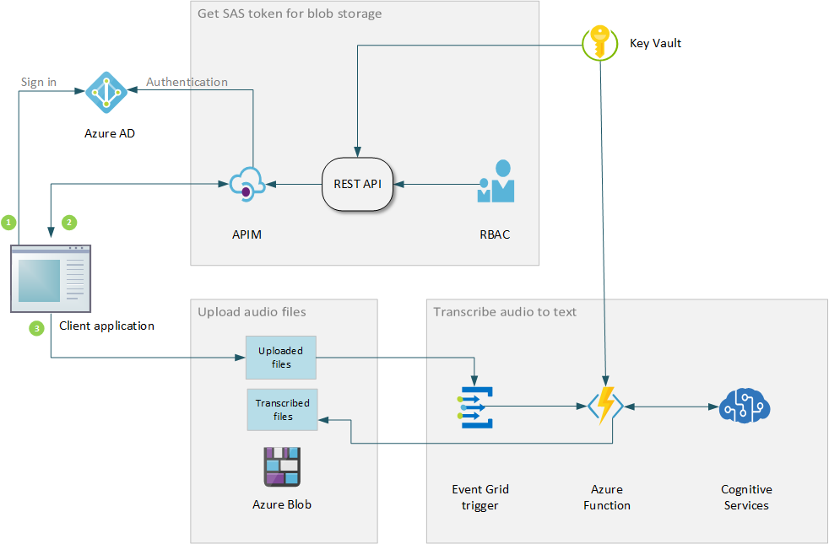
Speech Transcription
https://timw.info/59036

Slide 16
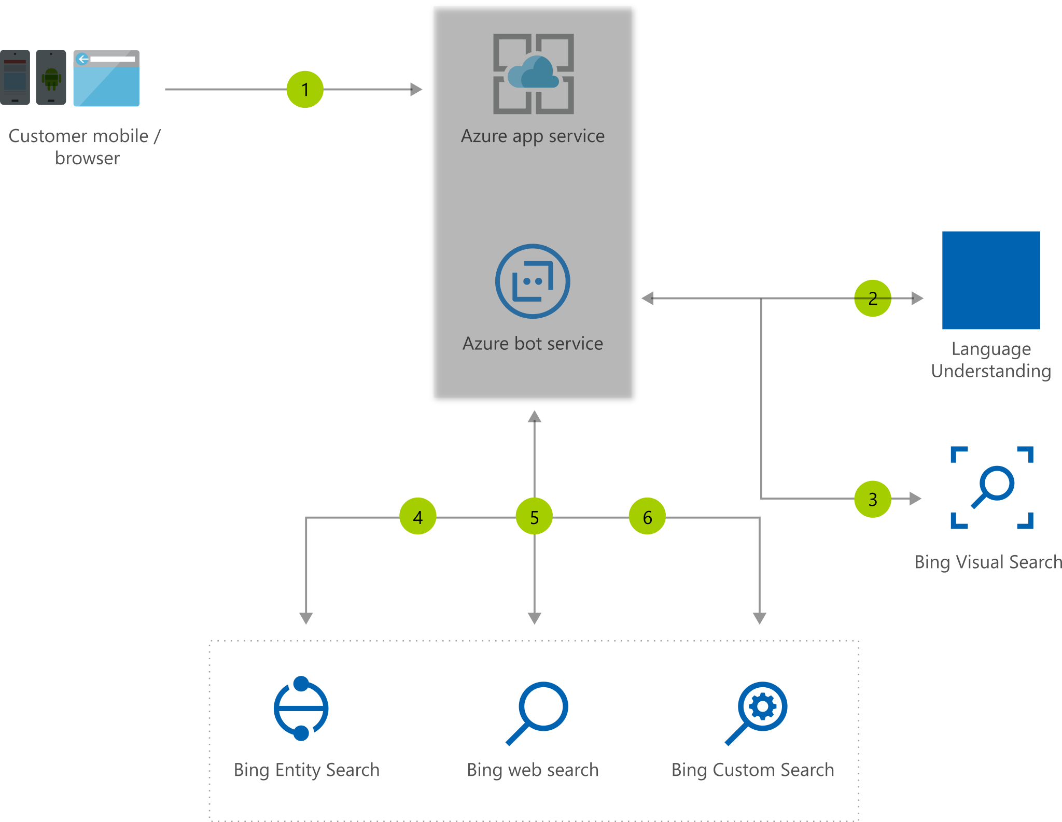
Visual Assistant
https://timw.info/380d7

Slide 17
Slide Title
timw.info/abcxy

Slide 18
Exam AI-100 Item Types

Slide 19

Single Answer Multiple Choice

Slide 20

Multiple Answer Multiple Choice

Slide 21
Repeated Scenario
You need to move an Azure VM to another hardware host.
Solution: You redeploy the VM.
Does this solution meet the goal?
Yes
No

Slide 22
Repeated Scenario
You need to move an Azure VM to another hardware host.
Solution: You enable boot diagnostics.
Does this solution meet the goal?
Yes
No

Slide 23

Select and Place

Slide 24

Build List and Reorder

Slide 25

Active Screen/Fill in the Blank

Slide 26

Case Study

Slide 27






Performance-Based Lab

Slide 28
Microsoft Online Testing

Slide 29

Microsoft Online Testing Process

Slide 30

Microsoft Online Testing Process

Slide 31

Microsoft Online Testing Process

Slide 32

Microsoft Online Testing Process

Slide 33

Microsoft Online Testing Process

Slide 34

Microsoft Online Testing Process

Slide 35

Microsoft Online Testing Process

Slide 36
Thank you!
Course materials: timw.info/ai100
Twitter: @TechTrainerTim
Work: timw.info/ps
Web: timw.info

